Slide 1
Thank you for your interest in the Data Strategist role at Harry S Truman College, one of the City Colleges of Chicago. It was such a pleasure learning more about you!
For the next round of interviews, you will be meeting with individuals that will inform the work of the Data Strategist. In addition to meeting with everyone, you are asked to complete a data scenario task that is designed for the hiring manage to get a better understanding of your skills in (a) data management/interpretation; (2) problem-solving; and (3) communication.
There is absolutely no wrong way to do this assignment nor should it be treated as high stakes.
Based on the preferred skills set of candidates, we anticipate this task taking no more than 1 ½ hour to complete.
More instructions about the data scenario task can be found on the next slides.
IMPORTANT NOTE:
You must submit a copy of your analysis and presentation no later than Wednesday, September 14 by 3:00 pm to Sean Hudson (shudson52@ccc.edu) and Araceli Gonzalez (agonzalez1109@ccc.edu). More information about the Master Spreadsheet is also on the next slide.

Slide 2
Data Scenario: Providing Strategic Insights
Harry S Truman College is leading the implementation of the Early Childhood Access Consortium for Equity (ECACE) Initiative for the City Colleges of Chicago (CCC) District. ECACE is a state funded initiative designed to increase the number of individuals in the early childhood workforce with associate, bachelor's, and master's degrees and other credentials. It will include a dedicated success coach who will support students enrolled in our Early Childhood Education (ECE) academic programs, and provide a scholarship to eligible students. Additionally, Truman leads multiple Early Childhood Education (ECE) strategic initiatives for the District.
The Office of Research and Strategic Planning has been asked to provide data that will support the implementation of the ECACE initiative, and provide insight into ECE academic outcomes. They have asked you, the data strategist who will lead this work, to provide with them any data that would be useful in their planning.
As the Data Strategist, you will often be asked to conduct analysis and provide insights on findings that you believe will be beneficial to the team. This is your data scenario task. You have been provided with an Excel file containing dummy completion and enrollment data. There are two parts to this task.
Part 1: Data Exploration
You will be conducting an exploration analysis of the data to further understand the current state of CCC’s ECE academic programs. As part of this analysis, you have been provided dummy completion and enrollment data of students enrolled in our various ECE academic programs. To inform how you want to explore and analyze the data, please read the Data Definition tab carefully to understand the variables in the dataset.
For this part of the exercise, you are free to use any statistical program to complete this exercise and display your answers, just make sure to include your work with your submission. If you decided to work in excel leave your graphs, formulas and/or pivot tables in the file. Or, if you use a different platform please send over a copy of your script/code.

Slide 3
Data Scenario: Providing Strategic Insights
Part 2: Strategic Insights and Recommendations
Using some of the results of your analysis in Part 1, present your findings in a 10 minute presentation that adheres to the following format:
Brief summary of your experience and interest in the position (no more than 1 slide)
Highlights of your analysis, which can include graphs/charts (no more than 3 slides)
Limitations of analysis (no more than 1 slide)
Recommended next steps (no more than 2 slides)
Recommendations can include suggested metrics for tracking ECE enrollment, retention, or completion/transfer, further plans for analysis, or anything you think would be beneficial for the initiative from a research/evaluation component
Remember, information and data are often imperfect, limited, or aggregated. It will typically be your role to identify areas requiring further investigation.
REMEMBER:
You must submit a copy of your analysis and presentation no later than Wednesday, September 14 by 3:00 pm to Sean Hudson (shudson52@ccc.edu) and Araceli Gonzalez (agonzalez1109@ccc.edu)

Slide 4
ECE Data 2019-2022
Ross Hyman

Slide 5
Agenda
Content | Slides
About me | 1
ECE Data | 3
Limitations | 1
Next Steps | 1

Slide 6
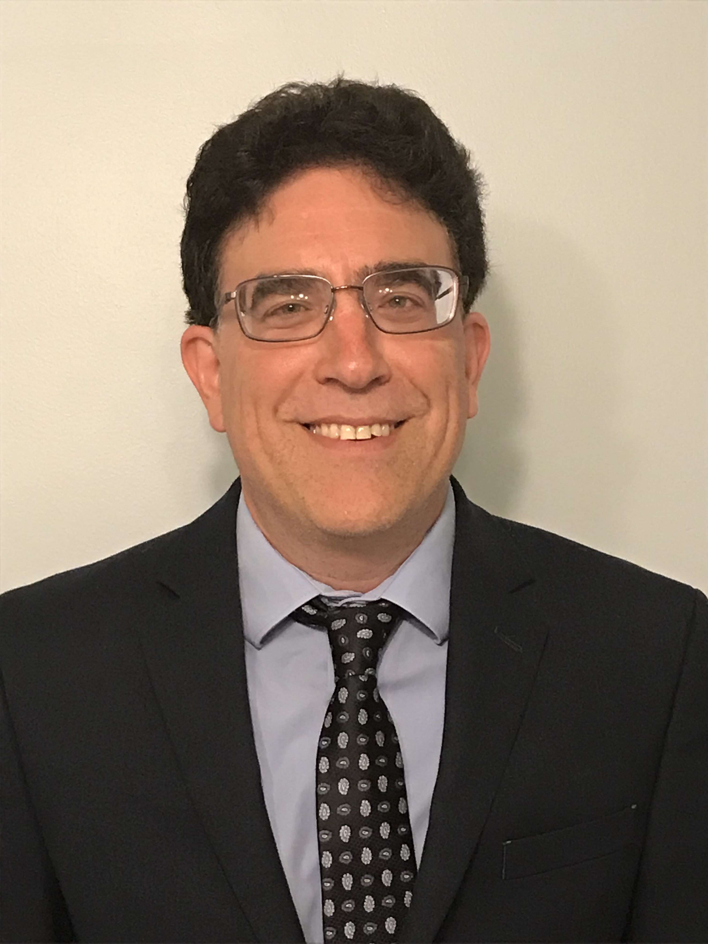
Ross Hyman
Indiana University, PH.D, physics
I love applying mathematical and computational physics techniques to scientific as well as social and economic problems to tell meaningful and actionable stories with data.

Slide 7
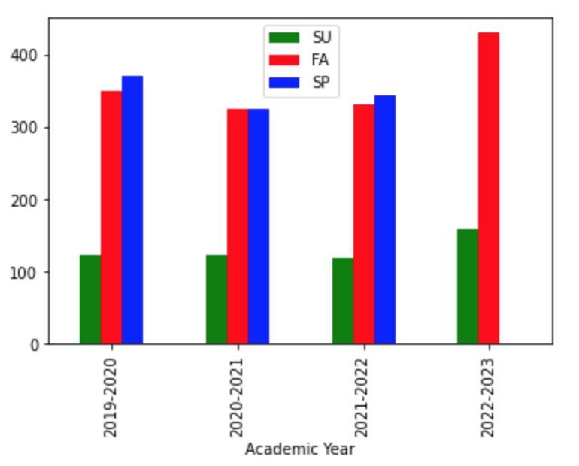
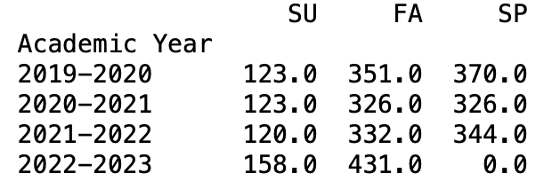
Enrollment 2019-2022
Fall 2022 enrollment up 30% from Fall 2021.

Slide 8
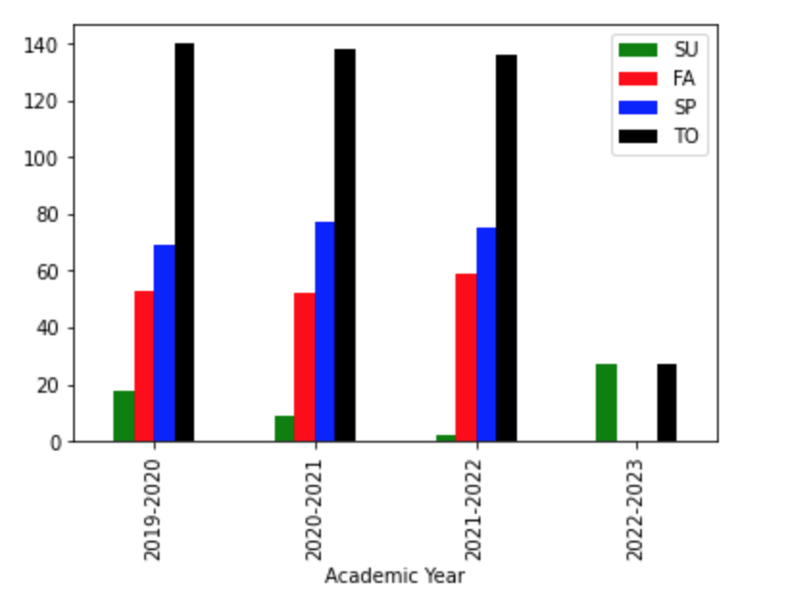
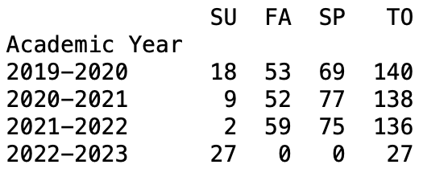
Graduated 2019-2022
Graduations steady.
Data for 2022 not complete.

Slide 9
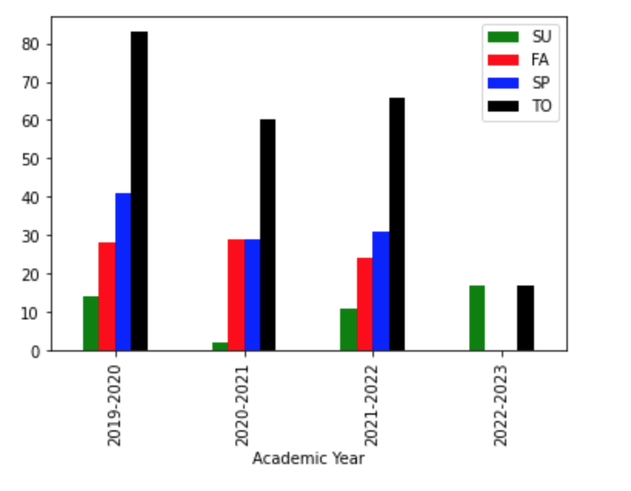
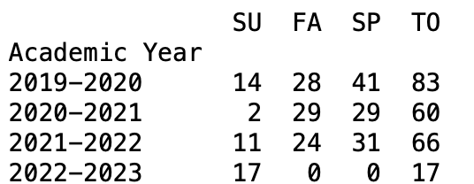
Dropped 2019 - 2022
Drops highest in 2019-2022.
Data for 2022 not complete.

Slide 10
Limitations
To determine length of time to complete each academic program, initial semester and year is needed.
It would be useful to know if students transferred into an ECE program.

Slide 11
Next Steps
Enrollment, graduation, and drop data by Race and Ethnicity is available in the notebook and can be incorporated into a presentation allowing more than 3 data slides.
Enrollment, graduation, and drop data can also be determined for each academic program using similar code.
Length of time to complete programs requires initial entry year.
Impact of coaches on enrollment, drops, and graduations could be deduced when coach data is available.

Slide 12
Thank You

